Slide 1

We aren’t just a staffing company. We’re a company that cares for others. It might sound lofty, but it’s the idea that gets us up every day, determined to make it true. Insight Global is a company that people can anchor to in moments of triumph, struggle, and every time in between. Whoever you are and wherever you come from, you matter to us and we have your back.
OUR CULTURE SHAPES EVERYTHING WE DO
Our Values
Everyone Matters
We Take Care of Each Other
Leadership is Here to Serve
High Character and Hard Work Above All Else
Always Know Where You Stand

Slide 2
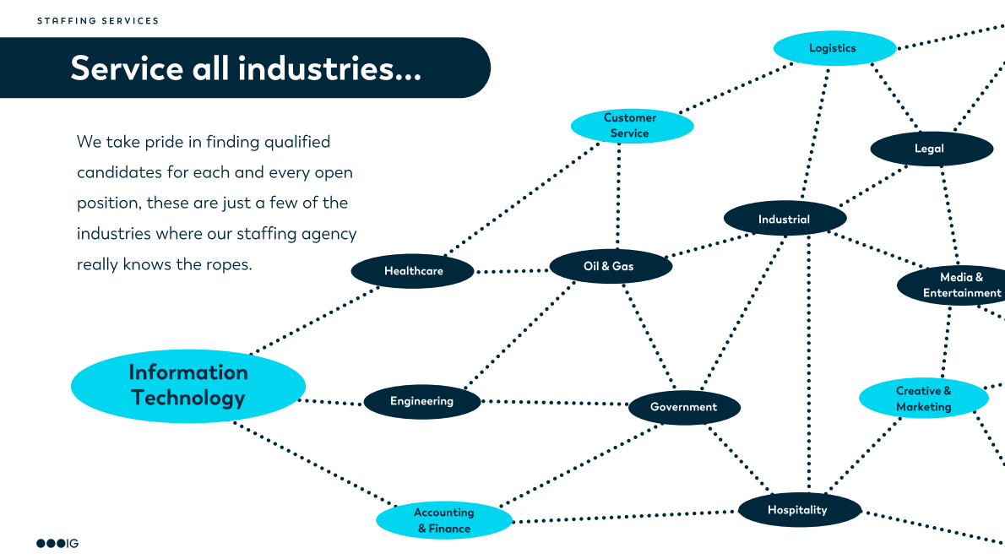

Slide 3
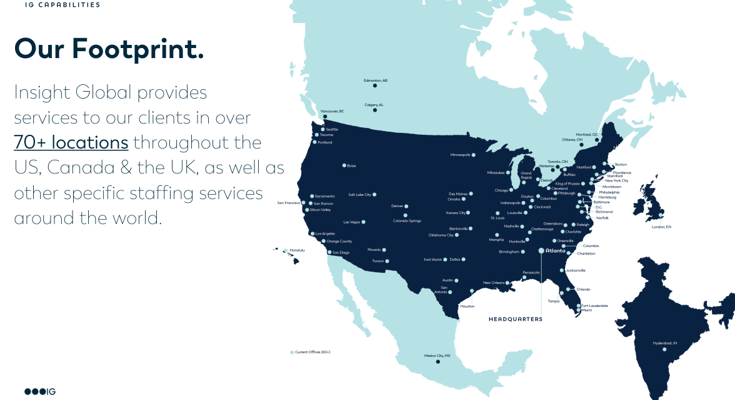

Slide 4

Our Impact
Local IT placements
Total: 150+
Shield Guard: 116 positions
IT & Finance
Cyber Innovations: 33 positions
Data & Customer Service
Annual industry placements:
Finance: 1500+
Network & service desk: 1300+
Marketing &Creative: 1000+
Customer Service: 3000+
Other: 50,000+
National IT placements
Total: 1300+
SecurNet Dynamics:980
Customer Service
HackSheild Tech: 4000
IT, Marketing, Finance

Slide 5

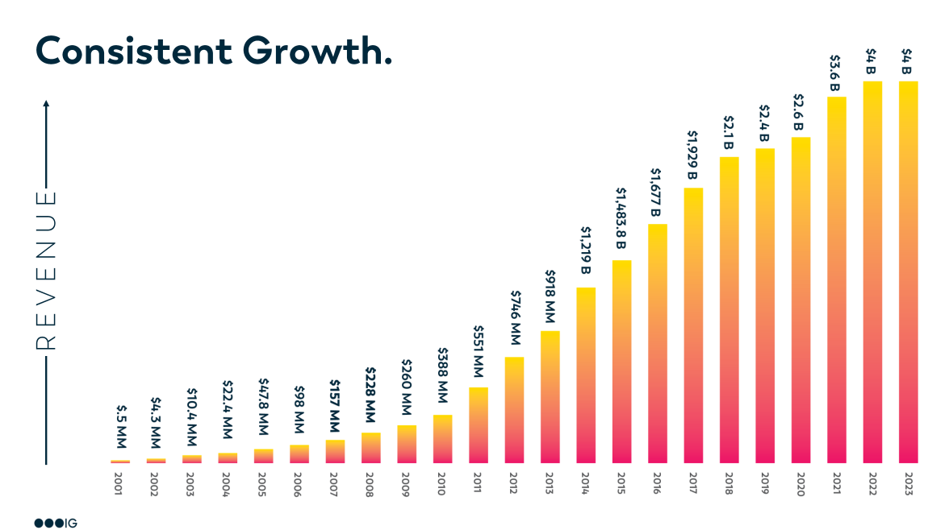

Slide 6

WHY INSIGHT GLOBAL?
800+ Fortune 1000 Clients
23+ Years of Experience
50+ Countries to Source Talent From
50,000+ Placed Hires Per Year
3,000+ Full-Time Recruiters & Account Managers

Slide 7
OUR IT EXPERTISE
30% OF TOTAL PLACEMENTS IN IT
2ND LARGEST U.S. IT STAFFING FIRM
2.7 BILLION IN IT STAFFING REVENUE IN 2021 = 8% MARKET SHARE
PRESCREENED CANDIDATES IN EVERY INDUSTRY
CYBER
SECURITY
AI
PROFESSIONALS
DATA
PRIVACY
THREAT
INTELLIGENCE
ANALYSTS

Slide 8




IT EXPERTISE
2ND LARGEST IT STAFFING
30% OF PLACEMENTS PER YEAR ARE IT PROFESSIONALS
SPECIALIZE IN SOURCING IT
PROFESSIONALS

Slide 9
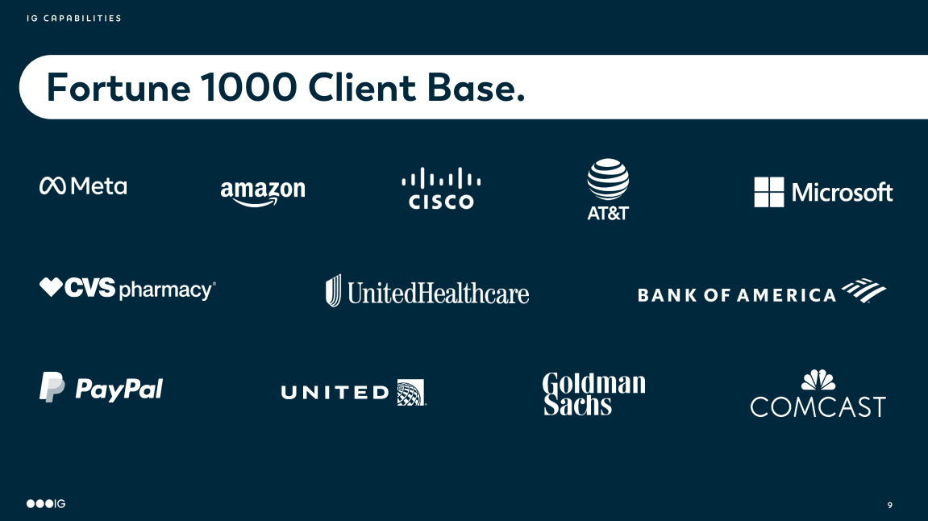

Slide 10
OUR SALES PROCESS
MEET & LEARN
ABOUT YOUR
OBJECTIVES
CONNECT &
INITIATE
PARTNERSHIP
FIND & REVIEW
POTENTIAL
CANDIDATES
INTERVIEW & OFFER QUALIFIED CANDIDATES
Hire & onboard
TOTAL ONBOARDING TIME: 1-3 WEEKS

Slide 11
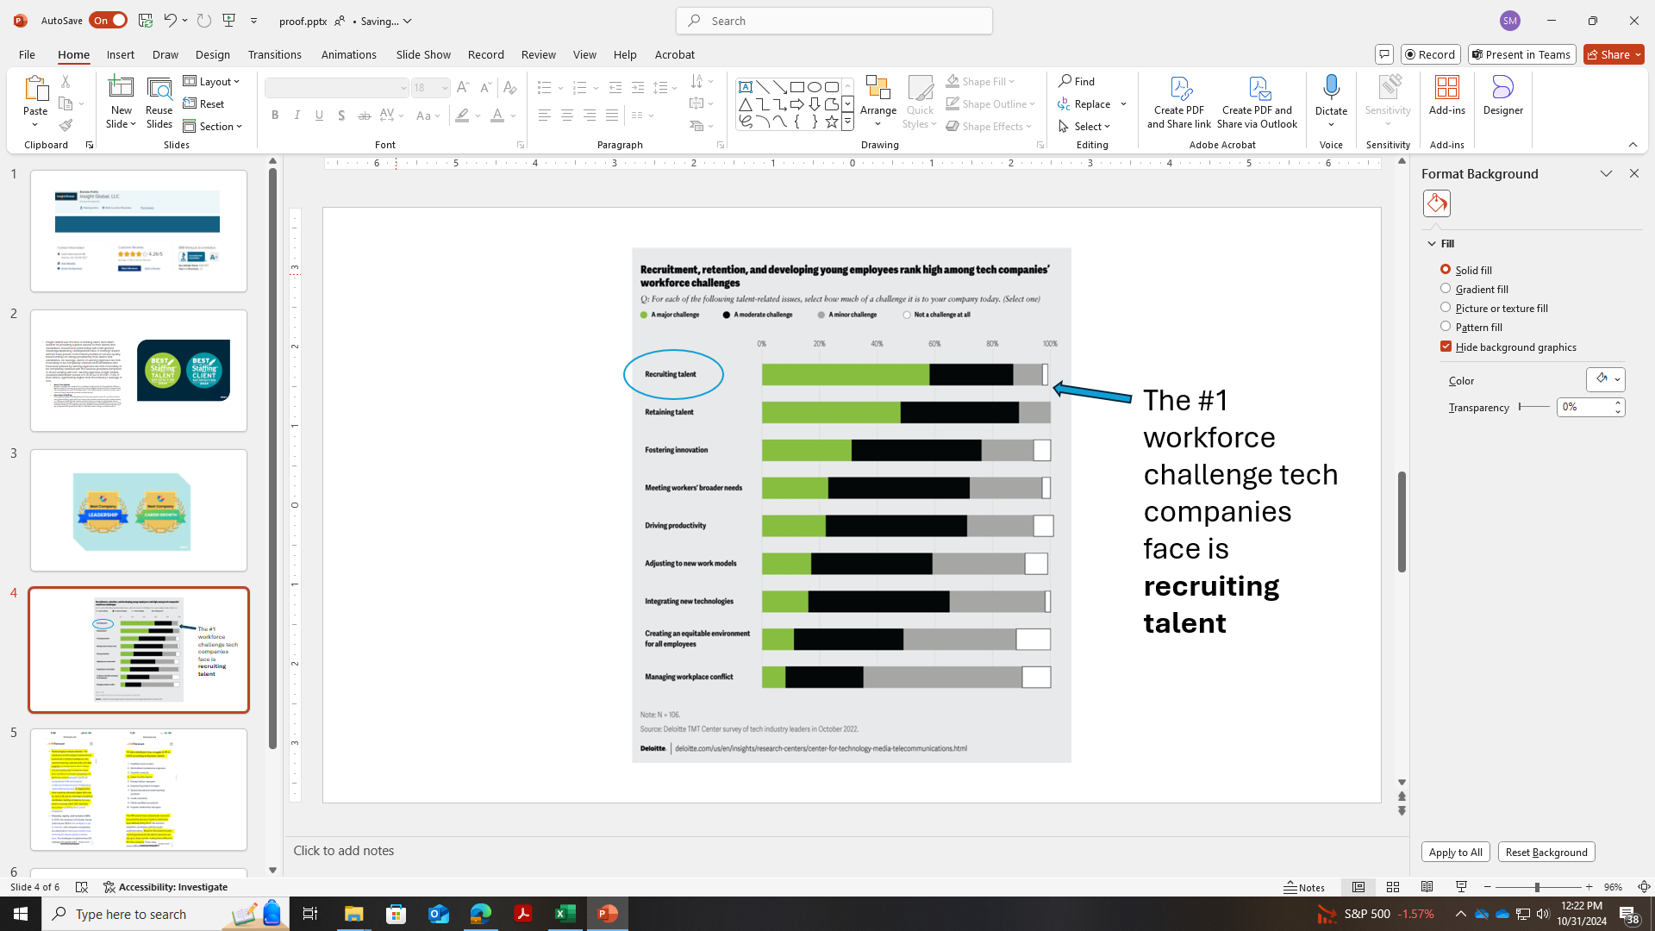

HR
HR CHALLENGES
AVG OF
44 DAYS TO FILL AN OPEN POSITION
Business Insider, July 2023

Slide 12





“Insight Global is always in tune with my needs & works diligently to find the right candidates; not just a volume of candidates.”
Shawn B.
T-Mobile
“The value add that Insight Global brings to the table: quality candidates, turnaround time, time spent with the team understanding the team culture. Insight Global makes hiring a breeze.”
Jeff P. Director of Analytics, Microsoft
PARTNER TESTIMONIALS

Slide 13
SCREENING PROCESS
70% REHIRE RATE
IN PERSON
INTERVIEW
WITH
ACCOUNT
MANAGER
IN PERSON
INTERVIEW
WITH RECRUITER
CANDIDATE
PHONE
INTERVIEW
PROFESSIONAL
reference
checks
background
check
SAVING CLIENTS AN AVERAGE OF $5000 PER HIRE ON SCREENING & ONBOARDING

Slide 14
AI PROFESSIONALS
SPECIALIZE IN SOURCING IT PROFESSIONALS
BIG DATA
CYBERSECURITY
DESIGNER
DEVELOPER
DEVOPS DEVELOPER
IT PRODUCT PROGRAM PROJECT MANAGER
QA STAFFING
SERVICE DESK OPERATIONS

Slide 15

EXPEDITED HIRING
3,000+ RECRUITERS ACROSS THE US, CANADA, AND THE UK
48-72 HOUR TURNAROUND TIME
COMPREHENSIVE PROPRIETARY DATABASE

Slide 16

YOUR ROI
ONBOARDING
ADMIN RELIEF
RESPONSIVENESS
Onsite or virtual orientation
Training & professional development programs
401k matching contributions
Payroll
Extensive benefit options
24/7 issue resolution
Monthly meetings to discuss job satisfaction

Slide 17
SAVINGS
Employee benefits, Onboarding, Payroll expenses, Time
marketing analysis on industry trends to prevent overspending
CONTRACT
Potential of employee turnover covered
(16-20% of employee wage)
Highly specialized talent
Test before you invest: mitigate risks, no long term financial commitment
Scaleability & Flexibility
PERMANENT
Employee placement fee collected after starting position (10%)

Slide 18




COST SAVINGS
POTENTIAL OF EMPLOYEE TURNOVER COVERED
(16-20% OF EMPLPOYEE WAGE)
BURDEN OF ONBOARDING THE EMPLOYEE IS COVERED (5%)
EMPLOYEE PLACEMENT FEE COLLECTED AFTER STARTING POSITION (10%)
MARKETING ANALYSIS ON INDUSTRY TRENDS CONDUCTED TO PREVENT OVERSPENDING

Slide 19
WHAT ARE BURDEN COSTS?
PAYROLL TAXES
EMPLOYEE BENEFITS
WORKERS COMPENSATION
TRAINING AND DEVELOPMENT
OFFICE SPACE AND EQUIPMENT
PAID LEAVE

Slide 20

CONTRACT EMPLOYMENT
TYPE BREAKDOWN
POSITION | SALARY PER INDIVIDUAL HIRE | INSIGHT GLOBAL FEES | TOTAL HIRING SPEND PER EMPLOYEE | TOTAL FOR ALL EMPLOYEES
DATA ANALYSTS | $70,000 | 12% | $78,400 | $548,800
BUSINESS ANALYSTS | $90,000 | 12% | $100,800 | $1,008,000
QUALITY ASSURANCE SPECIALIST | $70,000 | 12% | $78,400 | $392,000
CUSTOMER SUPPORT SPECIALIST | $50,000 | 12% | $56,000 | $840,000
TOTAL CONTRACT HIRING SPEND |  |  |  | $2,788,800

Slide 21
PERMANENT EMPLOYMENT
TYPE BREAKDOWN
POSITION | SALARY PER INDIVIDUAL HIRE | INSIGHT GLOBAL FEES | TOTAL HIRING SPEND PER EMPLOYEE | TOTAL FOR ALL EMPLOYEES
PROJECT MANAGERS | $90,000 | 15% | $103,500 | $828,000
LOGISTICS ANALYSTS | $70,000 | 15% | $80,500 | 1,207,500
TOTAL PERMANENT HIRING SPEND |  |  |  | $2,035,500

Slide 22

90%
of It companies plan to increase or maintain their use of independent contractors in the coming years
Research study from gusto

Slide 23
CONTRACT
VS
PERMANENT
Short-term need
Cost-efficient
Specialized skills
No long-term obligation
Long-term need
Stability
Compliance
Company culture
and loyalty

Slide 24


CYBER INNOVATIONS
As Cyber Innovations expanded its services, they encountered difficulties in sourcing skilled IT professionals in a competitive market. The need for timely placements and the right fit was crucial to maintaining their service quality and client satisfaction.
“ Thanks to their expertise, we were able to fill critical roles within weeks, allowing us to stay on schedule and elevate our services. Insight Global is now a trusted partner in our growth journey. “
-Jeff Davis,
Director of Talent Acquisition
Aggressive timeline to fill cybersecurity, project management, customer service, and data analyst roles for to meet the needs of their fast growing business
Insight Global utilized our efficient screening process and comprehensive database to promptly place 33 suitable candidates all within their deadline
RESULTS
CHALLENGE
SOLUTION

Slide 25

RESEARCH FROM EDIE GOLDBERG
SOCIETY FOR
HUMAN RESOURCE MANAGEMENT BOARD CHAIR
TOTAL COSTS TO HIRE=
3-4X
candidate salary
30-40%
hard costs
COSTS PER HIRE=
60-70%
soft costs

Slide 26
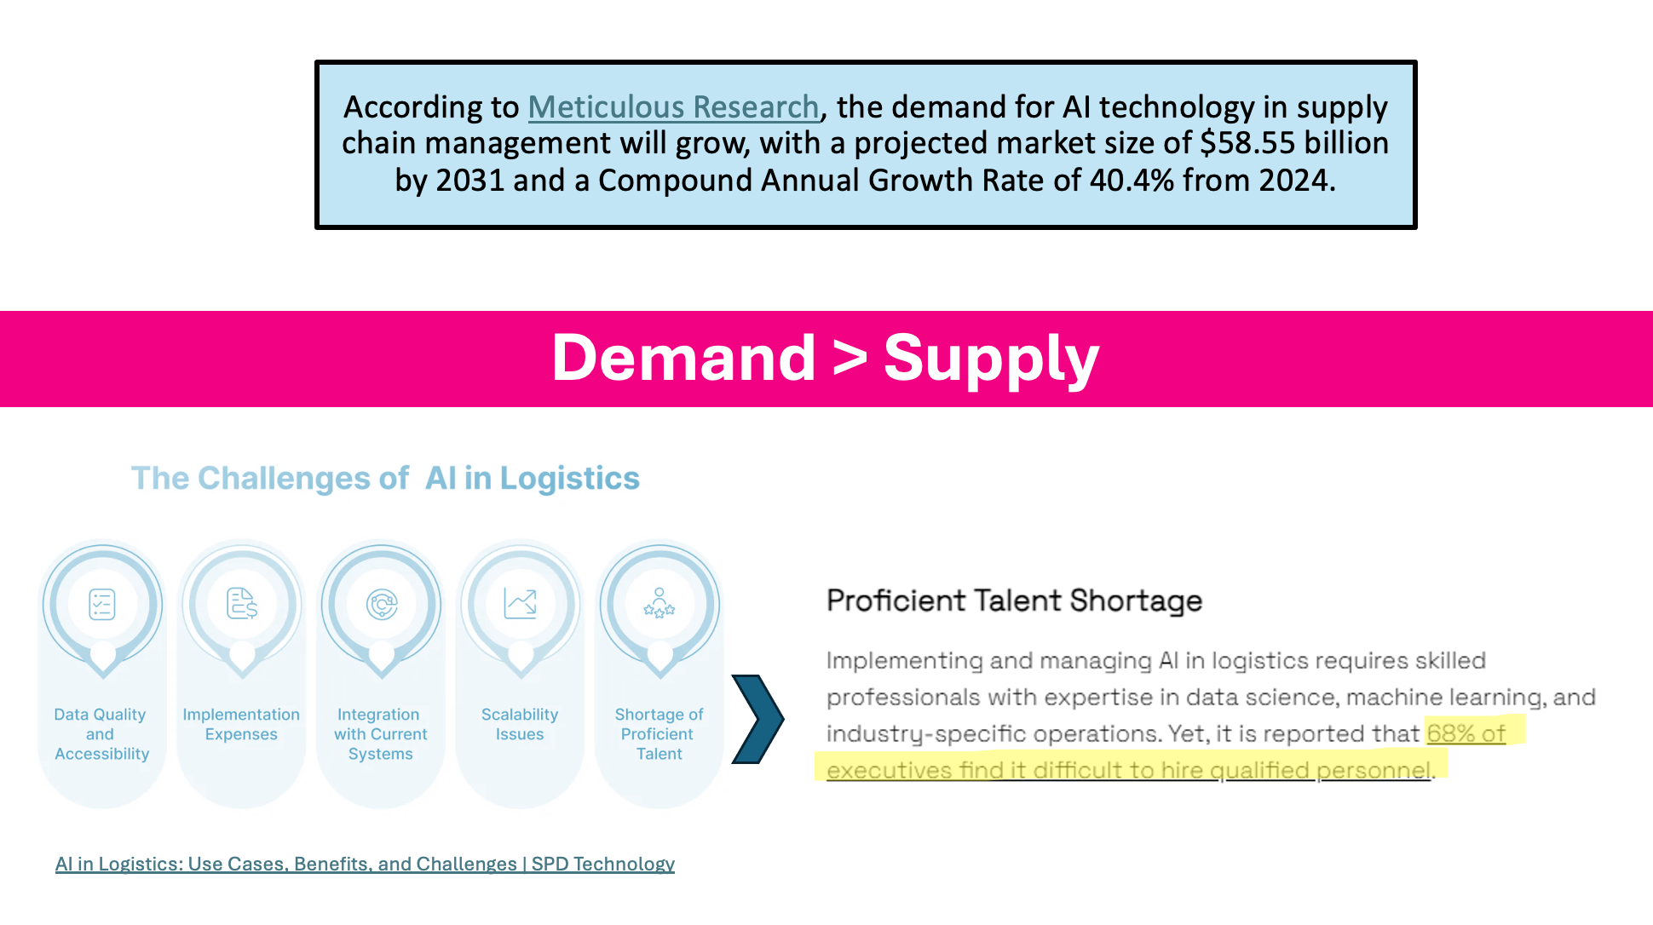

Slide 27
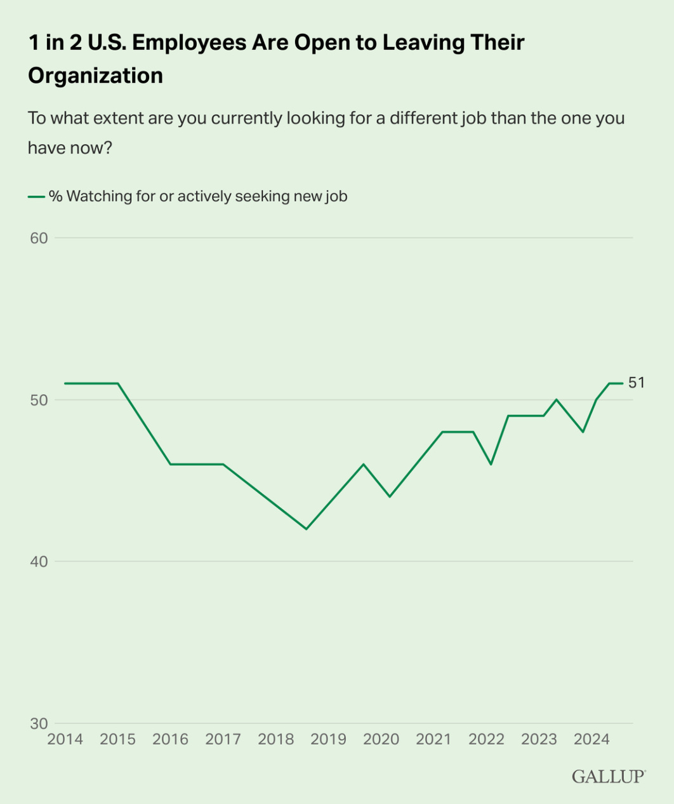
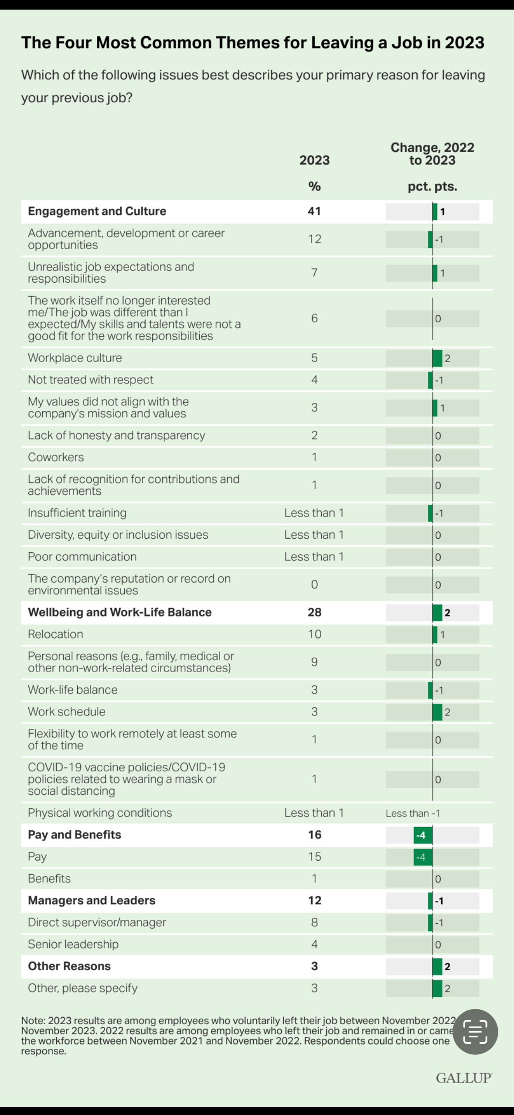
PASSIVE
CANDIDATES

Slide 28
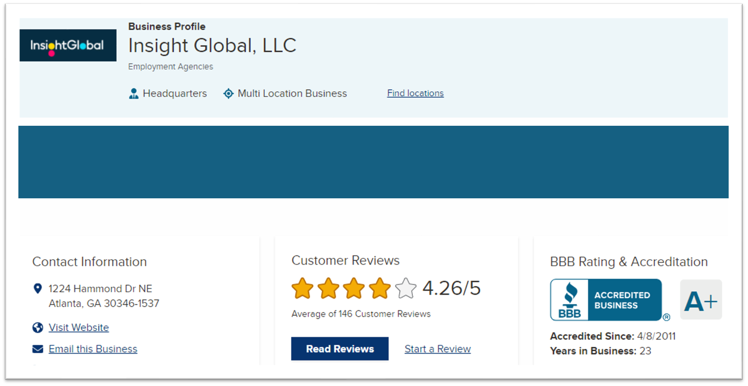

Slide 29


Insight global is always in tune with my needs & works diligently to find the right candidates; not just a volume of candidates.”
Shawn B.
T-mobile
“Insight Global's team aided in making a seemingly impossible task possible. They provided valuable insights in the conception & architecture of how we'd tackle a large hiring push & through close partnership, they pivoted & worked with us as needs changed."
Tim S.
Macy's Inc

Slide 30




STRENGTHS
5 tier
screening
process
2nd largest
IT staffing firm
strong culture of care
Work Within Your Budget

Slide 31



WEAKNESSES
based on 2024 hiring review
lengthy process caused 38% candidate loss
15% increase in employee attrition
Lack of contract hiring
knowledge
Over 27% of 2024 positions
unfilled

Slide 32




OPPORTUNITIES
for Cyberlogix in 2025
48-72 hour turnaround time
savings with 50% increase in contract hires
$30 million hiring budget
10% increase in employee retention

Slide 33




THREATS
Employee
Attrition
15% in 2023
20% increase
in new client
business
Burden
Costs
Budget
Allocation

